Slide 1
Implementation of Visible Light Communication Link
Supervisor Dr. Nikhil Sharma
Co-Supervisor Dr. Divyang Rawal
Akhil Bachkaniwala 16UCC010
Anubhuti Jain 16UEC019
Jyoti Kumari 16UEC052
Shrutika Bansal 16UEC064

Slide 2
Why Visible Light Communication ?
The Radio Frequency (RF) communication has limited spectrum which is congested and hence not enough to satisfy the requirements.
RF communication requires a separate setup for transmission and reception of RF waves.
RF communication is also prone to interference due to frequency reuse.
Overcoming the above limitations, Visible Light Communication is a preferred communication technique because of its higher bandwidth and immunity to interference from electromagnetic sources.

Slide 3

Advantages of VLC:
The low bandwidth problem in RF communication (3 kHz-300 GHz) is resolved in VLC because of the availability of the larger bandwidth (430 THz to 790 THz).
The VLC receiver only receives signals if they reside in the same room as the transmitter, therefore the receivers outside the room of the VLC source will not be able to receive the signals and thus, it has the immunity to security issues that occurs in the RF communication systems.
As a visible light source can be used both for illumination and communication, therefore, it saves the extra power that is required in RF communication.

Slide 4
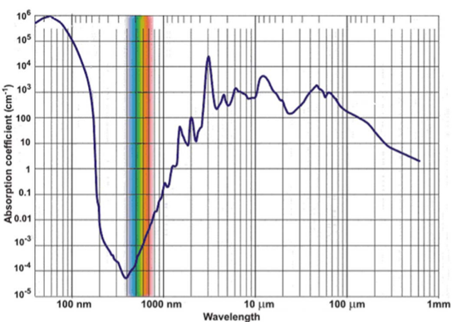
Visible Light Spectrum can be of advantage due to its lower absorption underwater.
Keeping in view the above advantages, VLC is one of the promising candidates because of its features of non-licensed channels, high bandwidth and low power consumption.

Slide 5
Problem Statement
Present underwater communication systems involve the transmission of information in the form of sound or electromagnetic (EM) waves.
Since radio waves cannot be used under water because these waves are strongly absorbed by sea water within feets of their transmission and this renders it unusable underwater.
There is a need for a robust and reliable communication system which will not be affected severely due to thermal and chemical changes in water’s composition.
Our goal is to develop a prototype which is able to transmit information from one end to another in atmospheric conditions initially.

Slide 6
Solution
Since light can travel through water, VLC based communications can offer much greater mobility. It is a method of communication via LED lights and can be a potential solution to this problem.
VLC devices have a system of blinking lights that are used for transmitting data.
These rapidly changing LED lights flash to enable data to be transferred over a Morse code-esque system of blinks.
The LED flashes emit lights that correspond with a computer language comprised of zeros and ones.
The lights emissions are then lodged in a gadget that computes and translates the signal into real-time data.
As the flashes blink faster and faster, data is able to be transmitted more quickly.

Slide 7
Objectives:
Part One:
Serial data Communication of characters.
Sensory data transmission and plotting the real time data using prototype.
Bulk data transmission using prototype.
Part Two:
Simulation of Optical Wireless Communication channel.
LOS channel results.
Blocked channel results.

Slide 8
Part One: Setup
Li-Fi Nano V2
Li-Fi Nano V2
Data Transmission
Arduino
Arduino
Processing Software
MATLAB
MATLAB
Processing Software
Transmitter
Receiver

Slide 9
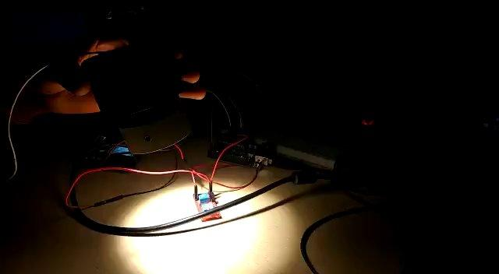
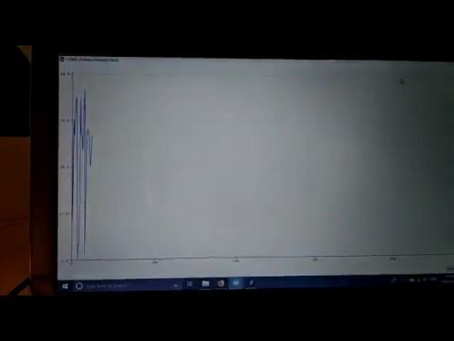
Results
Sensor Data Transmission

Slide 10
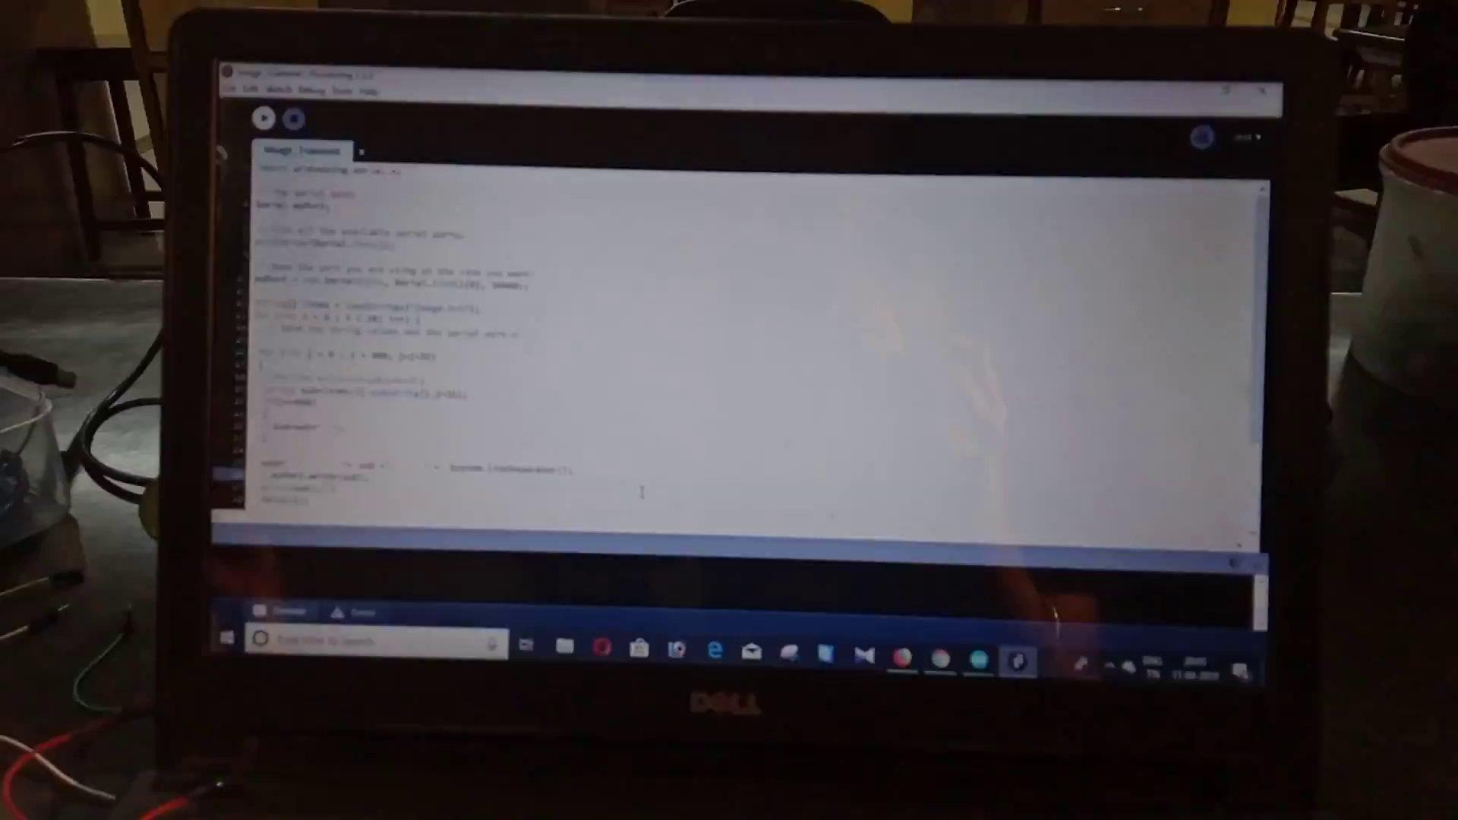
Data Transmission

Slide 11
Result :
Baud Rate 9600 (Symbols per second)
Maximum Distance 1m.
Serial Data, Sensor Data and Bulk Data Transferred Successfully.
Hence a proof of concept of using LiFi in Underwater Communication has being demonstrated for atmospheric conditions.

Slide 12
Part Two
Simulation of Optical Wireless Communication Channel

Slide 13
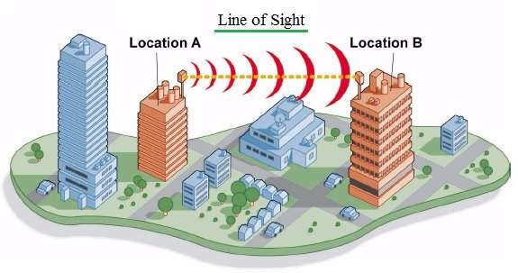
LOS Channel
LOS communication is possible when there is no obstruction between transmitter and receiver.
Due to less attenuation in the LOS communication, it offers good signal LOS deployment is possible when there is no obstruction between base station (BS) and mobile / fixed subscriber stations (SSs).
Strength and higher amount of throughput compare to NLOS counterpart.

Slide 14
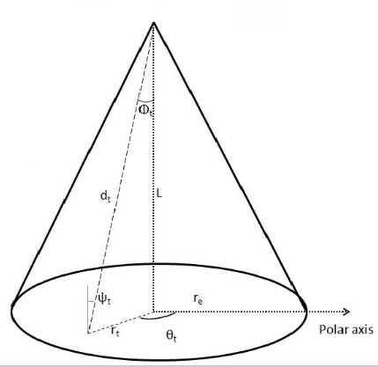
LOS Theoretical Analysis
The LED lamp is placed at height L from the t^{th} end user located with angle θ_{t} and radius r_{t} on the polar coordinate plane. The maximum radius covered by an LED cell is r_{e}. It is observed that the LED follows a Lambertian radiation pattern with order
m = −1/log₂(cos(φ_{1/2}))
where φ_{1/2} represents the semi-angle of LED.

Slide 15

Channel Gain Equation
Channel gain of the LOS link between LED and t^{th} user is given as
where
A denotes the detector area
R_{p} represents the responsivity of photodetector
d_{t} is the Euclidean distance between LED and t^{th} user
U(t) and g(t) represent the gain of optical filter and optical concentrator
cos(ψ) = cos(φ) = L/d_{t}
d_{t} = (r_{t}² + L²)^{½}

Slide 16
Parameters used in the simulation
A : Area of the detector where lie Receiver samples (meter square)
theta : Half-power semi-Angle of the LED cone (degree)
m : Order of Lambertian Emission
Ts : Gain of Optical Fiber
Psi_c : Field of view at the Receiver (degree)
n : Refractive Index
height : Height of Transmitter from base (meter)
samples : No. of Receiver samples at different distances
radius : Radius of the LED cone
Phi : Angle of Irradiance (degree)
Psi : Angle of Incidence
d : Distance between Transmitter and Receiver

Slide 17
Simulation - Step by step
Initialization all the parameters required.
Random assignation of Receiver samples in the area of base circle of the LED cone.
Calculation of order of Lambertian Emmision using the given formula.
Calculation of angle of irradiation for each sample by using its coordinates.
Measurement of channel gain using the before-mentioned mathematical formula.
Using the above calculated values, calculation and plotting of Probability Distribution Function with different values of channel gain.
CAlculation of Signal -to-Noise Ratio using transmitted power, bandwidth and received power.

Slide 18
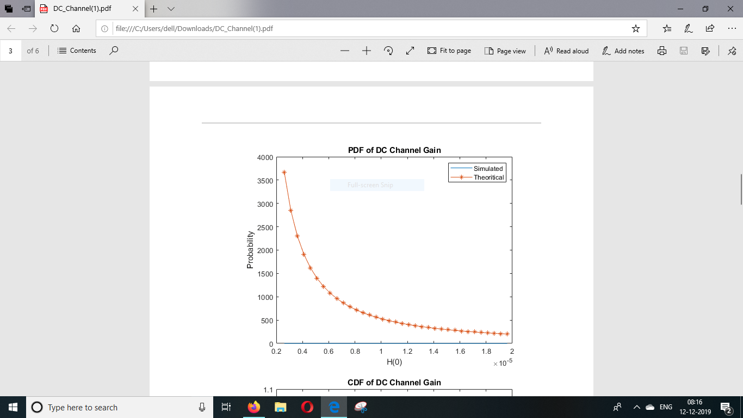

Slide 19
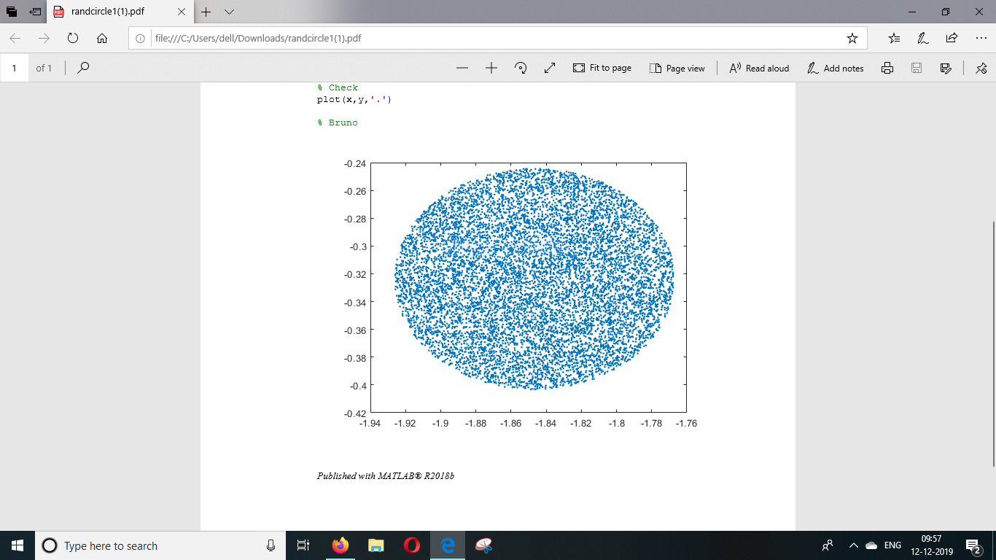
09.05.XX
11.01.XX

Slide 20
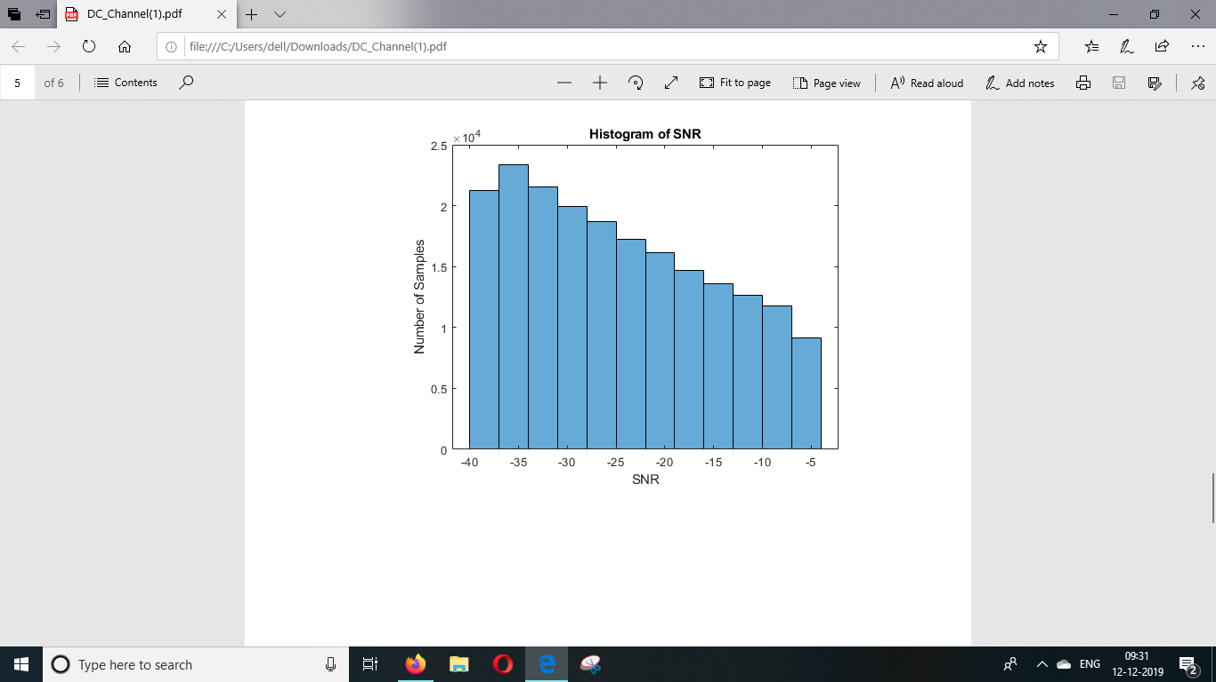

Slide 21



Expression of Probability Density Function of Channel Gain in LOS Scenario:
where
A constant for the considered system

Slide 22
Channel Gain under Blocking Scenario
Two Questions that arise:
What is a blocked scenario?
How to model such a scenario?
Answer to the first part:
A blocked scenario refers to the case where certain of the UE equipments aka Photodetector are completely blocked(hidden) from the Photo Source as compared to the LOS links.

Slide 23
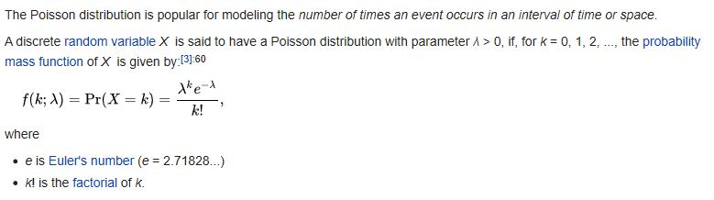
The second part: Modelling a Blocked Scenario
By using the Poisson Distribution to do so since blocking is a rare occurrence and the number of the total samples used are large during a given time interval T.
Lamda here can also be called the arrival rate of blockage.

Slide 24
Now that we know the LOS PDF and modelling blockage using Poisson. Using the before expression to obtain the PDF of Channel Gain in Blockage Scenario.
PDF of Blockage Scenario(k,h) = Lamda*Time*(PDF of NLOS(h)) + (1 - Lamda*Time)*(PDF of LOS(h))
Here
k = Number of occurrences of blocked UE.
h = Channel Gain
Lamda = Arrival Rate of Blockage
Time = The duration of the Process (taken to be one for simplicity)

Slide 25
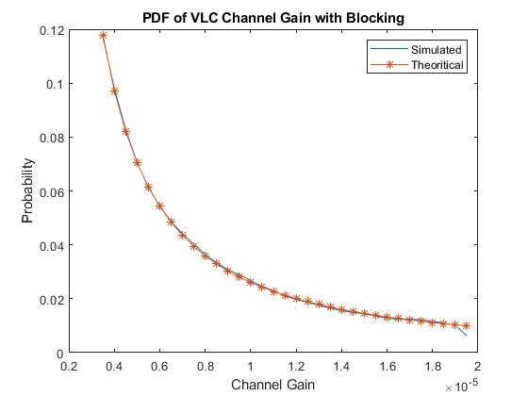
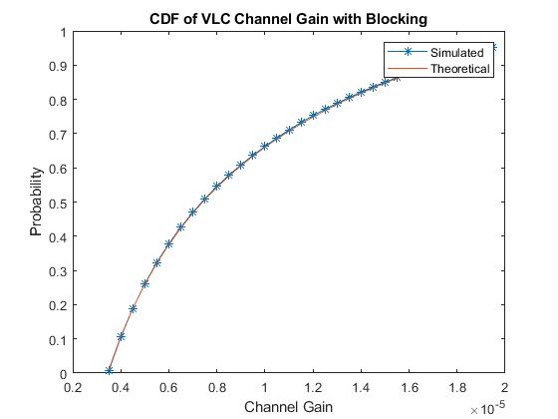
Results

Slide 26
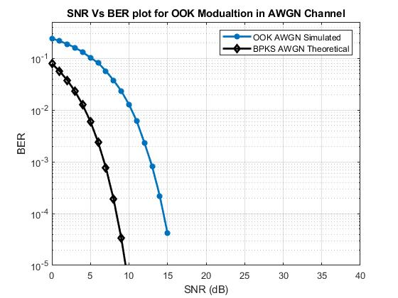
Results: BER VS SNR for On Off Keying

Slide 30
Conclusion
Serial Data Transfer has being successfully achieved.
End to End sensor data transfer has also being achieved.
Image transmission model has also being prepared.
Hence a proof of concept of using LiFi in Underwater Communication has being demonstrated for atmospheric conditions
Theoretical evaluation of VLC channel model has been done.
Understood what LOS channel is and derived theoretical results related to it.
Understood what Blocking channel is and derived theoretical results related to it.

